Slide 1

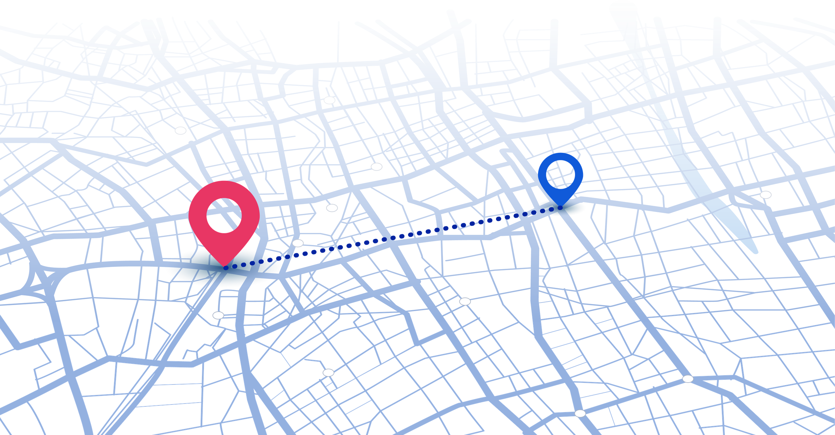
SMART EMERGENCY VEHICLE
PRIORITY SYSTEM
SUBMITTED BY
ROHITH.S [24619164]
JEREMIEL JOSEPH.S [24619115]
GURU RAHUL.R [22619187]
PROJECT GUIDE
MS.SHANTHI
Page 1 of 19

Slide 2
INTRODUCTION
Emergency vehicles such as ambulances and fire engines can face significant delays due to traffic congestion and signalized junctions. This project proposes a Smart Cascading Emergency Vehicle Priority Network that uses wireless communication to connect multiple traffic junctions. When an emergency vehicle is detected at one junction, the system provides priority at that junction and forwards the emergency information to upcoming junctions, allowing them to prepare in advance. The prototype uses ESP32, LoRa wireless communication, traffic signals, and optional GPS to demonstrate faster emergency response, coordinated signal priority, and automatic restoration of normal traffic operation.
Page 2 of 19

Slide 3
ABSTRACT
This project presents a Smart Cascading Emergency Vehicle Priority Network designed to reduce delays faced by emergency vehicles at multiple traffic junctions. The proposed system uses ESP32 microcontrollers and wireless communication modules such as LoRa to connect a series of intelligent traffic-signal junctions. When an emergency vehicle is detected at one junction, the system provides local signal priority and forwards the emergency information to the next junction, enabling upcoming junctions to prepare before the vehicle arrives. The prototype demonstrates emergency detection, wireless message forwarding, cascading junction preparation, safe signal preemption, and restoration of normal traffic operation, providing a low-cost approach for coordinated emergency vehicle movement.
Page 3 of 19

Slide 4
PROBLEM STATEMENT
  Emergency vehicles often face delays due to traffic congestion.
  Multiple traffic-signal junctions can further increase emergency response time.
  Upcoming junctions may not receive advance information about an approaching emergency vehicle.
  Conventional systems may respond only when the vehicle reaches the detection area.
  There is a need for junction-to-junction communication to provide advance emergency information.
  Upcoming junctions should prepare the traffic signal before the emergency vehicle arrives.
  The system aims to provide coordinated and safe signal priority across multiple junctions.
Page 4 of 19

Slide 5
OBJECTIVE
The main objective of this project is to reduce the delay of emergency vehicles at traffic junctions by detecting the vehicle, providing signal priority, and sending emergency information to upcoming junctions so they can prepare in advance. The system aims to enable faster, safer, and coordinated movement of emergency vehicles through multiple traffic signals.
Page 5 of 19

Slide 6
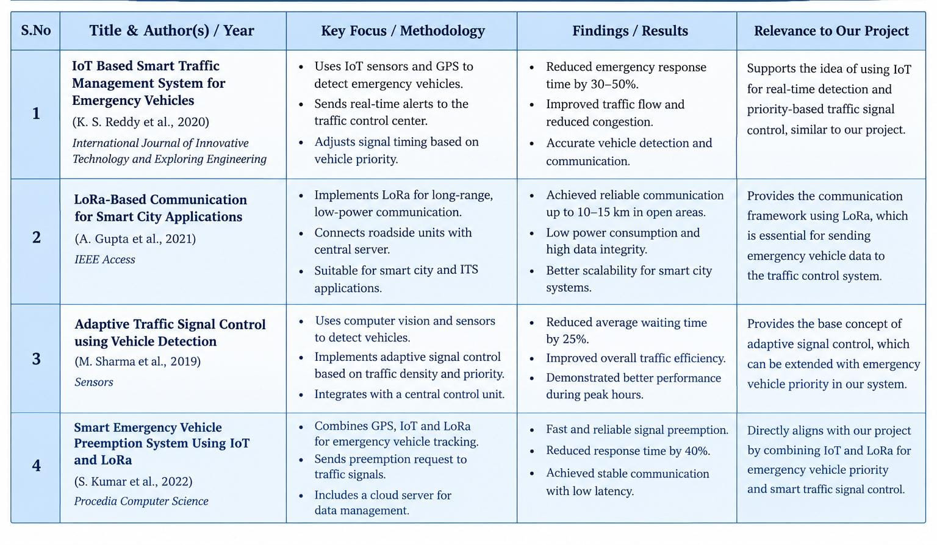
LITERATURE SURVEY
Page 6 of 19

Slide 7
RESEARCH GAP
Existing systems often focus on vehicle detection, wireless communication, or adaptive traffic control separately. There is a need for an integrated system using ESP32 and LoRa to detect emergency vehicle requests, forward messages between multiple junctions, and prioritize traffic signals to support faster emergency vehicle movement
Page 7 of 19

Slide 8
EXISTING SYSTEM
CURRENT APPROACH
PROBLEMS
The existing system uses Emergency Vehicle Preemption (EVP) to detect emergency vehicles and provide priority at traffic-signal junctions. The traffic signal responds when the emergency vehicle is detected and allows it to pass with priority.
  Upcoming junctions may not receive advance emergency information.
  Each junction may respond independently.
  The emergency vehicle may face delays at multiple junctions.
  There is limited junction-to-junction communication for advance preparation.
  Valuable emergency response time can be lost due to traffic congestion and signals.
Page 8 of 19

Slide 9
PROPOSED SYSTEM
INPUT
PROCESSING
Emergency vehicle activates the system → ESP32 detects it → LoRa sends the emergency information.
The current junction gives priority and forwards the information to the next junction. The next junction prepares the signal before the emergency vehicle arrives.
OUTPUT
The traffic signal becomes green for the emergency vehicle, upcoming junctions are prepared, and after the vehicle passes, the signals return to normal operation.
Page 9 of 19

Slide 10
SYSTEM ARCHITECTURE
EMERGENCY VEHICLE
DETECTION
ESP32 DATA
PROCESSING
START
JUNCTION 2
SIGNAL
JUNCTION 1
SIGNAL
LORA
TRANSMISSION
JUNCTION 3
SIGNAL
TRAFFIC SIGNAL
CONTROL
EMERGENCY VEHICLE
PASSES
RESTORE NORMAL
TRAFFIC
END
Page 10 of 19

Slide 11
METHODOLOGY
1. Emergency Vehicle Detection – Detect the emergency vehicle using an emergency switch and ESP32.
2. Emergency Information Generation – Generate the vehicle ID, type, emergency status, current junction, next junction, direction, and priority.
3. Wireless Communication – Send the emergency information using LoRa communication.
4. Junction Processing – The ESP32 at the junction receives and verifies the emergency message.
5. Signal Priority – The current junction provides a safe priority signal for the emergency vehicle.
6. Cascading Communication – The junction forwards the emergency information to the next junction.
7. Advance Preparation – The next junction prepares its traffic signal before the emergency vehicle arrives.
8. Vehicle Passage & Restoration – After the vehicle passes, the system monitors clearance and restores normal traffic operation
Page 11 of 19

Slide 12
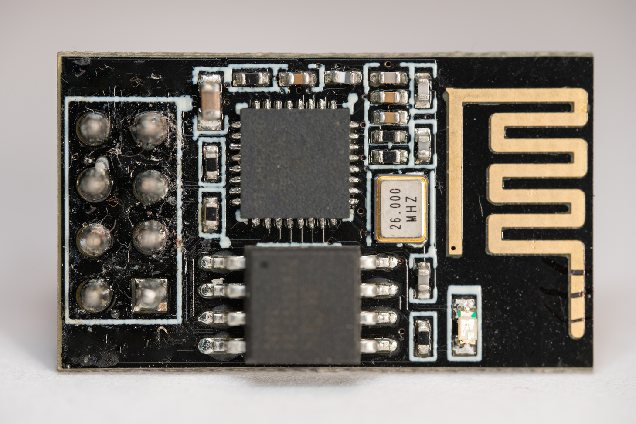
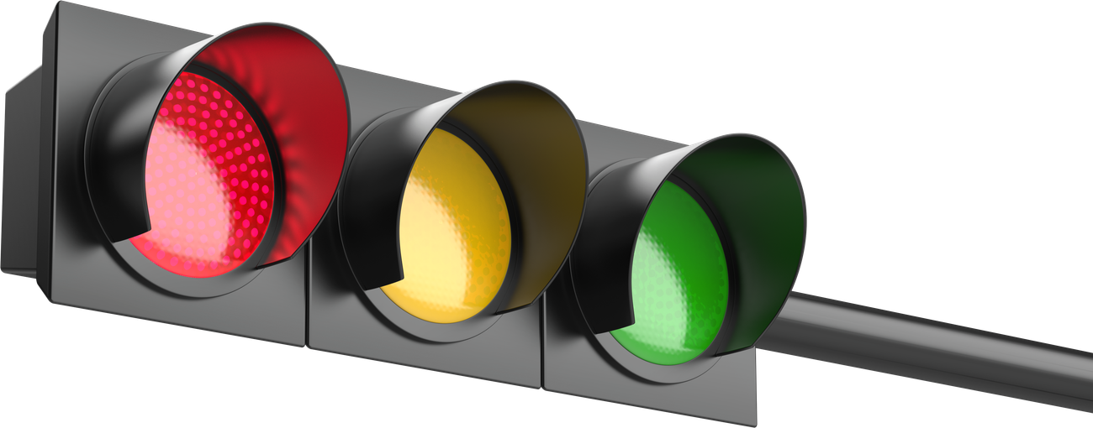


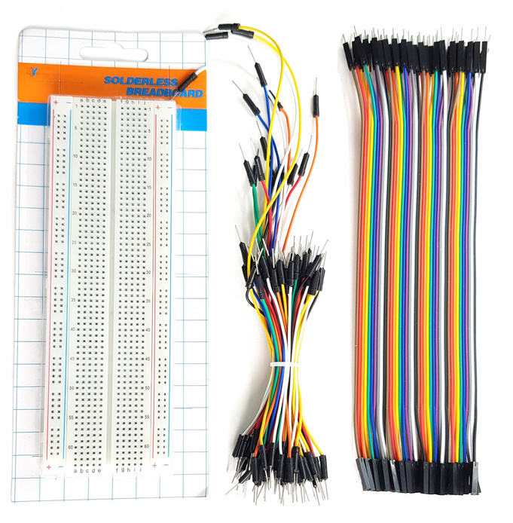
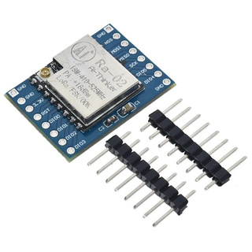
TECHNOLOGY USED
HARDWARE
SOFTWARE
  ESP32 BOARD
  LORA MODULE
  TRAFFIC MODULE
  BREAD BOARD
  JUMPER WIRES
  LED DISPLAY
  ARDUINO IDE
  EMBEDDED C/C++
  SIMULATOR
  ESP32 BOARD SUPPORT
  SERIAL MONITOR
  GOOGLE COLLAB
LED
Page 12 of 19

Slide 13
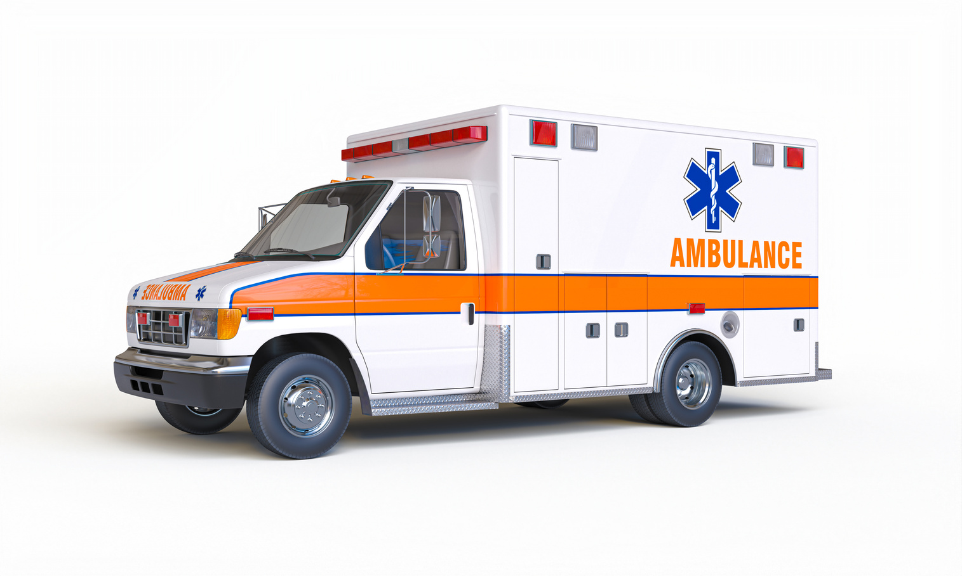


DATASET
  VEHICLE ID
  VECHICLE TYPE
  GPS LATITUDE
  GPS LONGITUDE
  JUNCTION ID
  EMERGENCY STATUS
  TRAFFIC DENSITY
  SIGNAL STATUS
  LoRa MESSAGE STATUS
  PRIORITY STATUS
Page 13 of 19

Slide 14
IMPLEMENTATION
  HARDWARE SETUP
  EMERGENCY DETECTION
  DATA PROCESSING
  WIRELESS COMMUNICATION
  JUNCTION COORDINATION
  PRIORITY ASSIGNMENT
  TRAFFIC SIGNAL CONTROL
  SYSTEM TESTING
Page 14 of 19

Slide 15
RESULT
The proposed IoT and LoRa-Based Emergency Vehicle Preemption System provides a smart approach to emergency traffic management. By integrating ESP32 microcontrollers and LoRa communication, the system aims to transmit emergency requests between multiple traffic junctions and prioritize traffic signals for emergency vehicles. The proposed solution can help reduce vehicle waiting time, improve traffic coordination, and support faster emergency response. The system's performance will be evaluated through hardware testing of communication reliability, signal response time, and junction coordination.
Page 15 of 19

Slide 16
FUTURE ENHANCEMENT
The proposed IoT and LoRa-Based Emergency Vehicle Preemption System provides a smart approach to emergency traffic management. By integrating ESP32 microcontrollers and LoRa communication, the system aims to transmit emergency requests between multiple traffic junctions and prioritize traffic signals for emergency vehicles. The proposed solution can help reduce vehicle waiting time, improve traffic coordination, and support faster emergency response. The system's performance will be evaluated through hardware testing of communication reliability, signal response time, and junction coordination.
Page 16 of 19

Slide 17
CONCLUSION
In the future, the proposed system can be enhanced with AI-based traffic prediction, GPS route optimization, cloud monitoring, and smart city integration. These improvements can increase system efficiency, improve coordination between multiple junctions, and support faster emergency vehicle movement.
Page 17 of 19

Slide 18
GANTT CHART
Page 18 of 19

Slide 19
Page 19 of 19

